Slide 1
From ski area spatial modelling to snowpack viability
H. François
P. Spandre, S. Morin et E. George
PySciDataGre, Grenoble, 8 février 2019

Slide 2
Framework
BD Stations
Rasters
psycopg2
gdal
numpy

Slide 3
Basics
Open rasters
dst_ds = gdal.Open(raster)
gt = dst_ds.GetGeotransform()
band = dst_ds.GetRasterBand(1)
array = band.ReadAsArray()
Filter and get vectorial data using SQL / spatial SQL

Slide 4
How do we locate in space ?
Cols
y
Rows
x

Slide 5
- 1 -
Ski area spatial modelling

Slide 6
From ski area to gravity area
All points reachable from the top of a ski-lift allowing skier to go back to the bottom of any ski lift within the same ski resort
Spatial information crossing
Skier inertia when he goes down
« non skiable » areas are exclude (slopes)
Agregate at the scale of a resort

Slide 7
The use of recursivity to select pixel in a cascade
def detect_down:
ref_mat = height[rmin:rmax,cmin:cmax]
tmptarget = target[rmin:rmax,cmin:cmax]
tmpsize = tmptarget.shape
targetzero = numpy.zeros((tmpsize[0], tmpsize[1]), numpy.int8)
targetzero = targetzero + 1 * numpy.logical_and(numpy.logical_and(numpy.logical_and((ref_mat - height[ref_p] < 0),tmptarget == 0), ref_slopes <= slopemax), ref_mat >= min
for n in numpy.argwhere(targetzero==1):
p = (n[0] + rmin, n[1] + cmin)
target[p] = 1
new_pt.append(p)
return new_pt
def ski_slope_down:
np = detect_down
for p in np:
ski_slope_down

Slide 8
Polygonization: create raster and shapefile
#create tmp raster
driver = gdal.GetDriverByName("GTiff")
skirast = driver.Create('test.tif', h, w, 1, gdal.GDT_Byte)
skirast.SetGeoTransform(mnt_trans)
srs = osr.SpatialReference()
srs.ImportFromEPSG(2154)
skirast.SetProjection(srs.ExportToWkt())
skirast.GetRasterBand(1).WriteArray(fromtop)
#create tmp shapefile for poligonyzation
driver = ogr.GetDriverByName('ESRI Shapefile')
tmpshp = driver.CreateDataSource('tmp.shp')
tmplayer = tmpshp.CreateLayer('tmp', srs)
tmplayer.CreateField(ogr.FieldDefn("val", ogr.OFTInteger))
gdal.Polygonize(skirast.GetRasterBand(1), None, tmplayer, 0, [], None)

Slide 9
Polygonisation: insert into BD Stations
tmplayer.SetAttributeFilter("val = 1")
j = 0
for feat in tmplayer:
geom = feat.GetGeometryRef()
if j == 0 and geom.GetArea() > 3125:
geom_wkb = geom.ExportToWkb()
geom = ogr.CreateGeometryFromWkb(geom_wkb)
fromtop_final = geom
j = 1
elif j == 1 and geom.GetArea() > 3125:
geom_wkb = geom.ExportToWkb()
geom = ogr.CreateGeometryFromWkb(geom_wkb)
fromtop_final = fromtop_final.Union(geom)
fromtop_wkt = fromtop_final.ExportToWkt()
query = """insert into stations.geo_dsa_building(ind,id_rm,fromtop_geom)
select %s::varchar, %s::varchar, ST_GeomFromText(%s,2154)"""
cur.execute(query,(sta[0],id_rm,fromtop_wkt,))
myconn.commit()

Slide 10
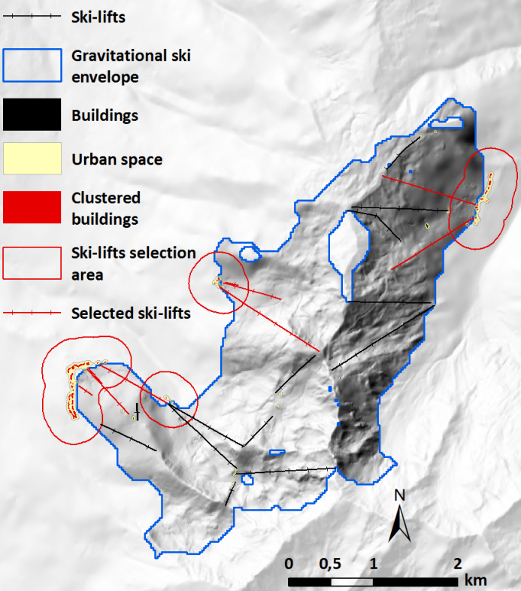
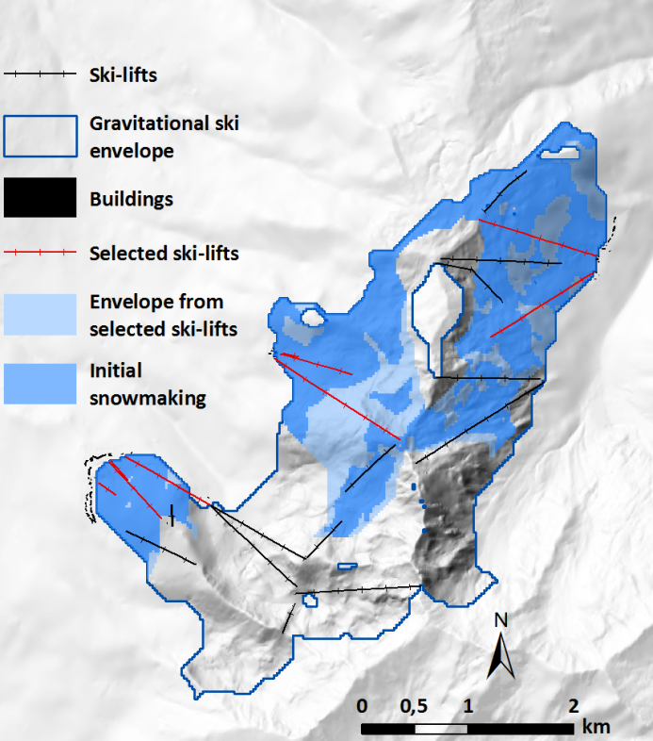
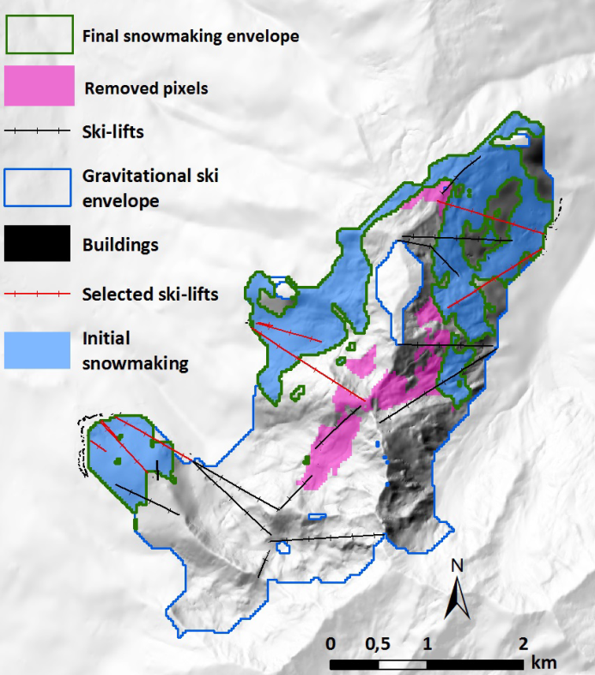
Spatial modelling of snowmaking area
1. Snowmaking near leisure real estate
2. Gravity area and slopes
3. Adjust to target

Slide 11
- 2 -
Cross with snow data

Slide 12
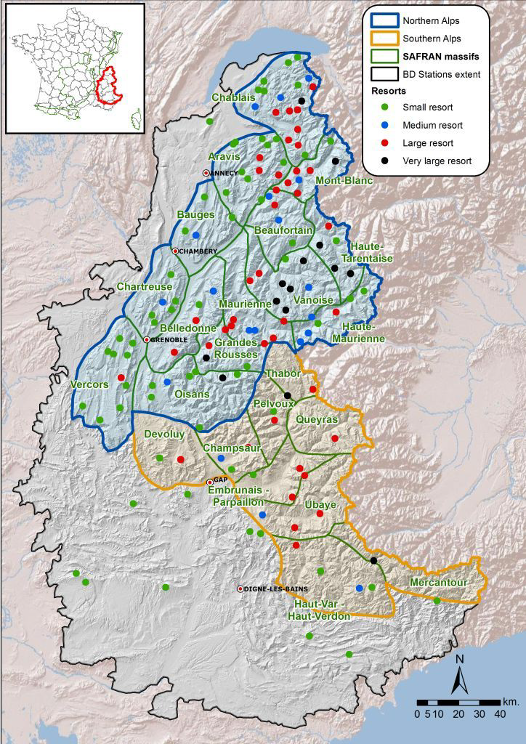
Basics
SAFRAN Mountain massifs
23 massifs around 900 km²
Elevation with 300m step
BD Stations
148 alpine ski resorts
Spatial information

Slide 13
Spatial interpolation of snow simulations
Reclass DEM and its derivatives
Identify localization type regarding standard values of mountain range, elevation, slope and aspect
Query the BD Stations database to retrieve snow data at different dates
Data storage into a numpy array
Output
Viability index
Snow cover raster

Slide 14
Ski area properties: elevations

Slide 15
Ski area properties: slopes

Slide 16
Ski area properties: elevations

Slide 17
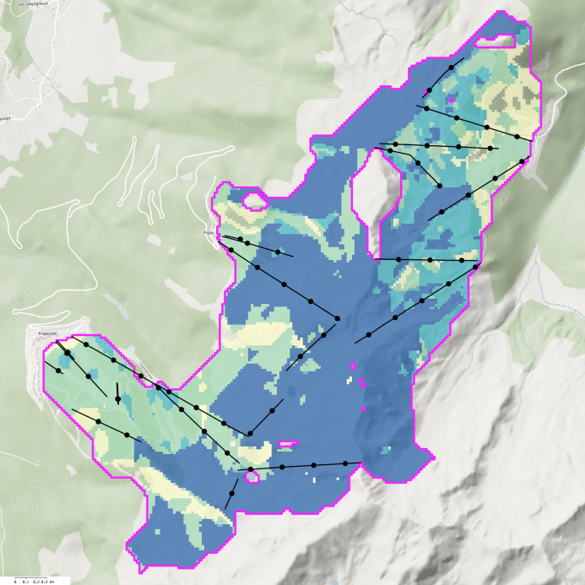
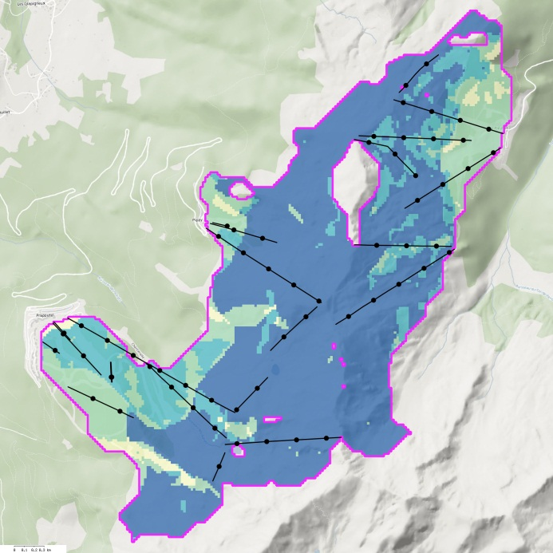
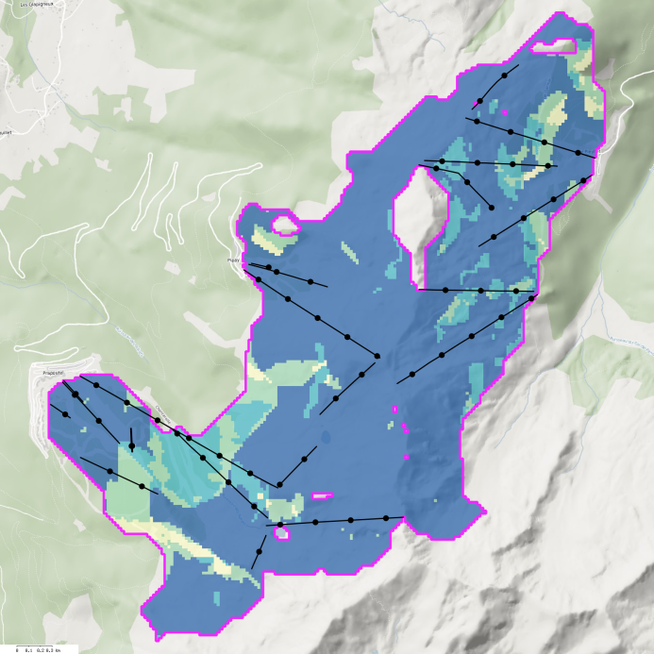
Snow cover in 2006-2007
1. Natural snow
2. Groomed snow
3. Managed snow

